Slide 1

Preventing Rewrites: Navigating from Legacy to DevOps
Escape Endless Discussions
Make Change Natural
Make Change Stick
TechnicalFluency.com
ARLO BELSHEE
arlo@digdeeproots.com

Slide 2

The Source of Rewrites
Notes:
Rewrites:
See a beautiful future
No incremental path

Slide 3

The Dream
Notes:
If we could just:
TDD all
Feature Flags
Right refactoring strategy
Right architecture

Slide 4

It’s Possible

Slide 5


What is a swamp?

Slide 6
What is a Legacy Code?

Slide 7
Prevent Rewrites: 2 Ways of Working
Makers
Menders
Create new things
Improve behavior
Preserve structure
Big, bold bets
“Hey code, do this!”
Change existing things
Preserve behavior
Improve structure
Tiny, invisible steps
“Hey code, what would you like to be?”

Slide 8
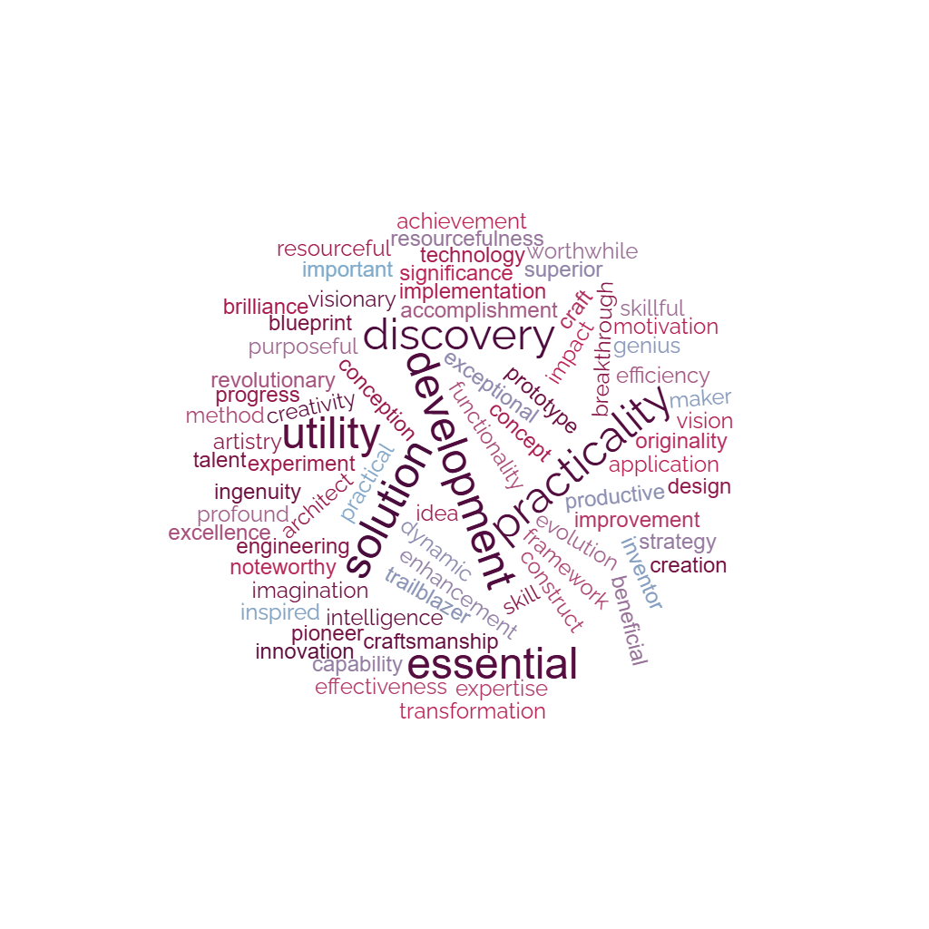
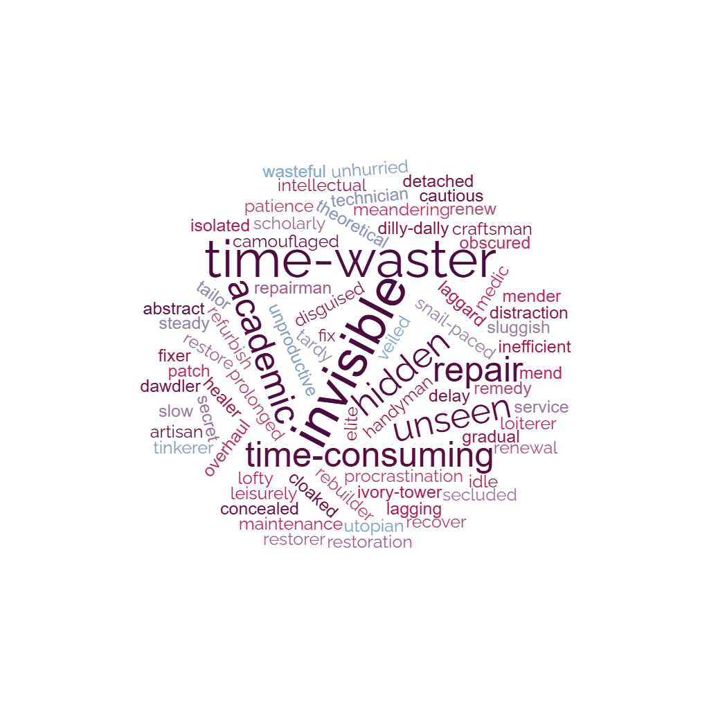
The Myth
Maker
Mender

Slide 9
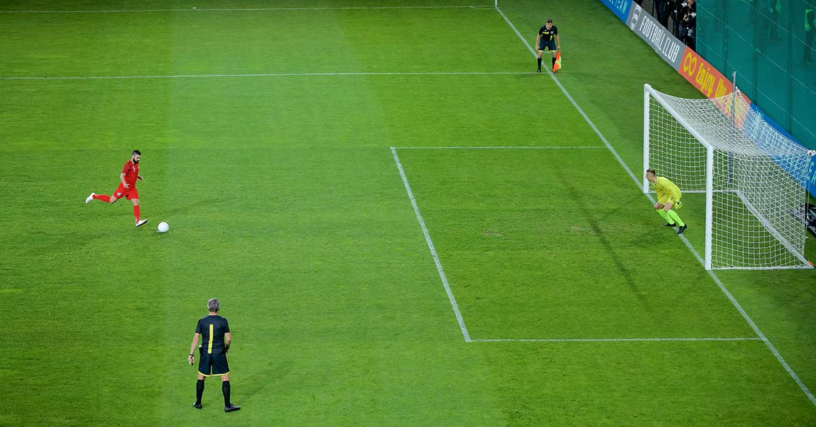
The Reality
Maker
Mender

Slide 10
Outcomes From 2 Ways of Working
Makers / Strikers
Menders / Midfield & behind
Take shots on goal
Get a point
Or lose possession
Win the game
Capture Immediate Value
Add net-new revenue
Trade-off: Value vs Cost
Maintain possession
Prevent opponent points
Create shot opportunity
Don’t lose the game
Create Long-term Sustainability
Protect all existing revenue
Trade-off: Possibility vs Risk

Slide 11
Notes:
Which is more visible? The goal you score, or the 50 goals you prevent with good ball control? Deep experts in the game – coaches – see the value of goal prevention. Interested onlookers – fans, owners – do not. What would happen if we let these external stakeholders set strategy & hiring for football teams? Lots of makers! More goals! Team scores all go up.

Slide 12
What if Fans Ran Hiring?
Makers

Slide 13
What if Fans Ran Hiring & Rules?
Makers

Slide 14
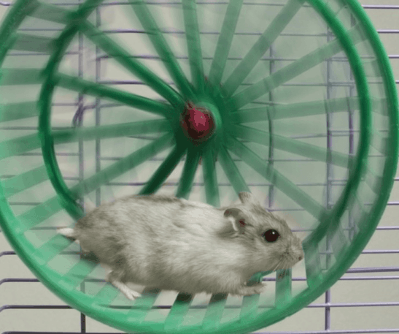
Most Companies: “99.9%” Makers
Low possession == game is out of your control
Adding new revenue erodes existing revenue
External forces erode existing revenue
Result: running fast to stay in same place.

Slide 15
The company is outside my control.

Slide 16
What if I Learned to Mend Some?
Pro
Con
Promotion
I become a rare commodity
I contribute across teams
Enjoyment
I get to work on clean code
Swamps don’t slow me down
Job security
Mending is harder for AI than Making is
Hard
Low organizational support for learning
Get blocked
Low organizational support for my mending work
No Job Security
Successes are invisible
Must expressly self-promote

Slide 18
3 Problems to Solve
Permission,
Strategy,
First Step
Too Hard
It’ll all Backslide
Unaligned
Unnatural
Un-sticky
Context Map,
Navigation Recipe
Supporting Contexts,
Gradualism Recipe
Context Transition,
Integration Recipe

Slide 19
Align
Getting from Endless Discussions to Strategy, Next Step, and Permission

Slide 20
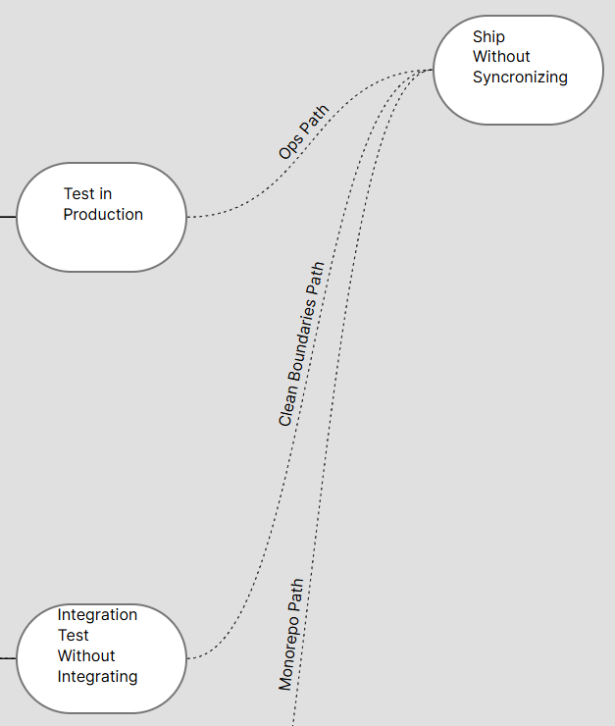
Navigation using Legacy Escape Maps
Pick your path
Sequence your technical shifts
Allow interdependent team progress
Mine are at https://technicalfluency.com

Slide 21
Example Argument – Too Many Good Ideas
Component APIs
Microservices
We should…
Unify Pipelines
Big services
Manage dependencies
Hexagonal Architecture
Better pre-integration testing
Separate databases
Dark Releases
Use Migrations
Monorepo
Fix coupling
Feature Flags
TDD

Slide 22
Recipe - Navigation
Distinguish Context and Behavior
Pick goal
Ground current context
Pick path
Define terms by context

Slide 23
Distinguish Context and Behavior
Behavior
Context
An action performed by an individual using a tool.
Extract Method:
Huh?
Cut & Paste
Inline-lambda-based recipe
Ctrl + R, M
The emergent state resulting from a bunch of people doing some particular set of Behaviors.
Refactoring is Safe and Easy…or not.

Slide 24
Recipe - Navigation
Distinguish Context and Behavior
Pick goal
Ground current context
Pick path

Slide 25
Recipe - Navigation
Distinguish Context and Behavior
Pick goal
Ground current context
Pick path

Slide 26
Recipe - Navigation
Distinguish Context and Behavior
Pick goal
Ground current context
Pick path

Slide 27
Example Argument – Permission to Refactor
I want to refactor!
No! It’s not safe! Do it right the first time!
Not safe?
What a time waste!

Slide 28
Recipe - Navigation
Distinguish Context and Behavior
Ground current context
Pick path
Define terms by context

Slide 29
Example Argument – TDD, TDD, or TDD?
It leads to long, flaky builds!
It is the only path to fast, deterministic builds!
It can’t find any of the real bugs!
It prevents us having to find everything in integration or production!
It supports refactoring!
It blocks refactoring!

Slide 30
Recipe - Navigation
Ground current context
Define terms by context

Slide 31
Recipe - Navigation
Distinguish Context and Behavior
Pick goal
Ground current context
Pick path
Define terms by context

Slide 32
Make Change Natural
Getting from Blocked to Effortless Forward Progress

Slide 33
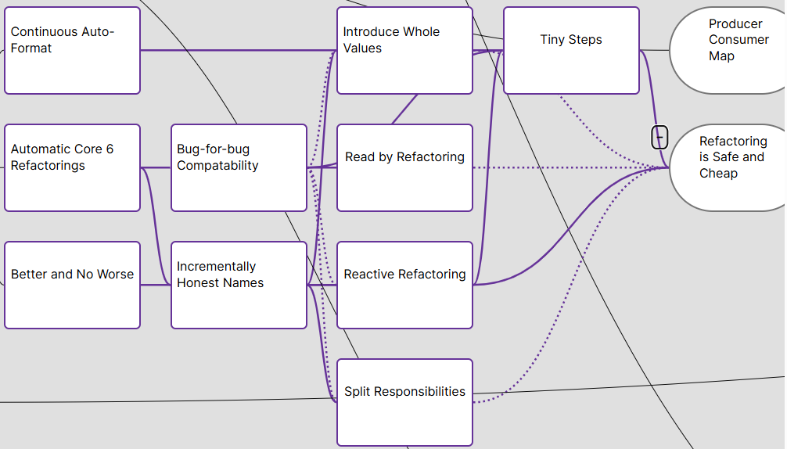
Gradualism
Today’s change is X
That change is supported
The context pulls us forward
5%
5%
5%
50%
5%
5%
5%

Slide 34
Example Hard Change
Try for good unit testing…
3-line tests
Customer intent & language
1,000 per core-second
No gherkin, just code
…with untestable code

Slide 35
Recipe - Gradualism
One context at a time
Blend contexts

Slide 36
Recipe - Gradualism
One context at a time
Blend contexts

Slide 37
Recipe - Gradualism
Step
Example
Trivial form for each behavior
Recipes & integrated recipe lookup
Trivial tool adopt w/o behavior change
3 tiny changes at once:
Autosave file on edit
Map Ctrl + S to commit
Rename via IDE shortcut
Git repo “Recipes”
Use git log history viewer in IDE

Slide 38
Recipe - Gradualism
One context at a time
Blend contexts
Trivial form for each behavior
Recipes & integrated recipe lookup
Trivial tool adopt w/o behavior change

Slide 39
Make Change Stick
Getting from Constant Backsliding to Committed Change that Outlasts Us

Slide 40
Integration
Change
Process
Tools
Measurement
Promotion
Management Conversation
Architecture
Expand, then Integrate
Alter other processes to leverage & require new behaviors
Complete a Context before integrating
Focus on Uniform Fluency over Proficiency or Depth

Slide 41
Example Backsliding
I refactor after every change
Refactoring as a part of all work
Manager Changes
I code as fast as I can

Slide 42
Recipe - Integration
Extend whole context, then repeat
Fluency over proficiency
Uniformity over depth
Change wider context
Then extend whole context again

Slide 43
Summary and Next Steps
 | Escape Endless Discussions | Make Change Natural | Make Change Stick
Get the idea | Navigation | Gradualism | Integration
Know the recipe | Distinguish Context and Behavior Pick Goal Ground Current Context Pick Path Define terms by context | One context at a time Blend contexts Trivial form for each behavior Recipes & integrated recipe lookup Trivial tool adopt w/o behavior change | Extend whole context, then repeat Fluency over proficiency Uniformity over depth Integrate / Change Wider Context
Practicing and failing
Change
Process
Tools
Measurement
Promotion
Management Conversation
Architecture
5%
50%

Slide 44
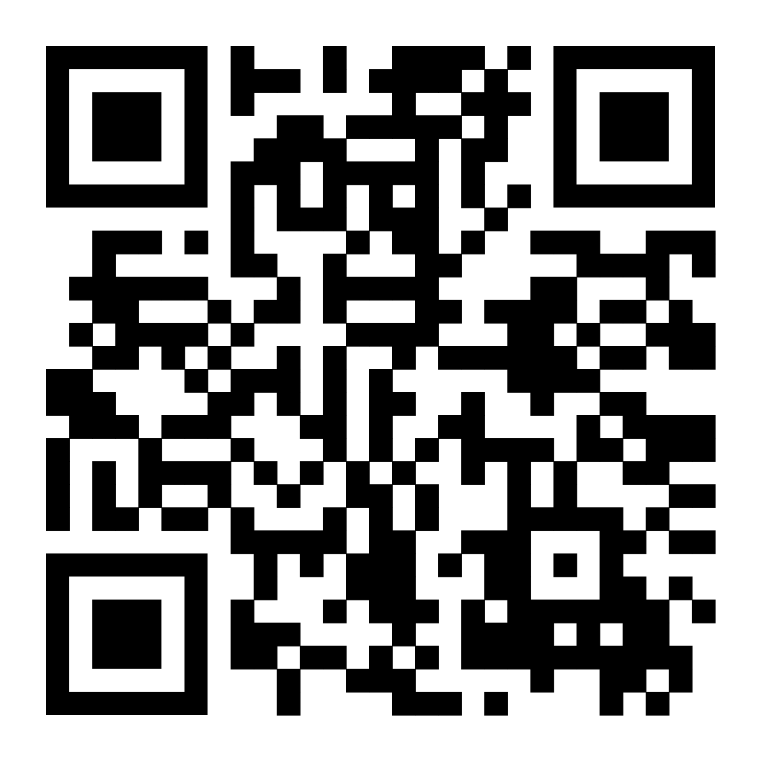
Get this Deck
https://talks.digdeeproots.com/craft2024-arlo.html

Slide 45
Goal: Shift from Maker to Part-mender
Expand
Integrate
Make Natural
Align with Team
Align with Self
Do on Core Problems
Make Natural
Do on Varied Problems
Coach
Demo

Slide 46
Goal: Shift from Maker to Part-mender
Marian Hartman’s Talk
Samman Technical Coaching
Align
Core
Ease
Wide
Invite co-learners and mentor (optional)
Pick shift for fingers & how to assess
Coach
Define core problem, recipe, & SCM tag; check it in
Follow recipe by-the-book
Reflect after each application & daily across SCM log
Demo
Demo, blog, or screencast
Show doing it & describe resulting mindshift
Guide someone else’s behavior (not mental model).
Varied problems. Vary & update the recipe.
Same reflection.
Use only questions & recipe.
Pick set of reinforcing small behavior shifts.
https://talks.digdeeproots.com/craft2024-arlo.html

Slide 47


Law of Relative Value:
The exact same Behavior has different Value in different Contexts

Slide 48
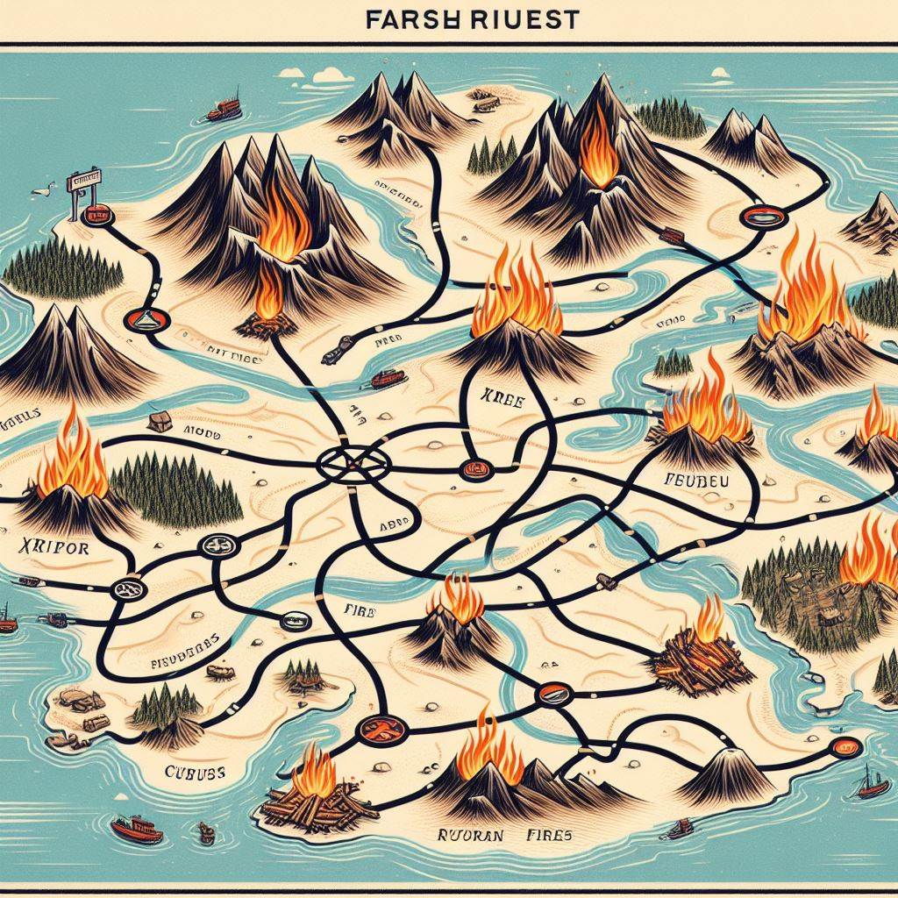
Fact: There are multiple good paths
And more bad ones
Let’s explore that on the map…

Slide 49

Law of Gravity:
Contexts are Stable Attractors
Let’s explore that on the map…

Slide 51
Corollary:
Entropy and Healing are the same force.
Me
Let’s explore that on the map…

Slide 53
Recommendation:
Entangle current and target contexts; activate both at once.
Let’s explore that on the map…

Slide 55


Law of Contextual Conversation:
The same words mean different Behaviors in different Contexts
Hacker
Hacker

Slide 57

Corollary:
Any plan or advice that crosses contexts either looks stupid or is stupid

